Slide 1


STATISTICS FOR ML

Slide 2

OUTLINE:
A- Data structures
B- Descriptive stats
Measures of central tendencies
Measures of dispersion
Measures of shape
Measures of position
Standard scores
Correlation and Causation
C- Inferential Stats
Probability
Hypothesis testing
ANOVA
Regression

Slide 3
Data Structures

Slide 4
Data
Is raw collection of individual facts or stats can be in a form of
Text
Observations
Figures
Numbers
Graphs

Slide 5
Machine Learning vs Statistical learning
Statistical learning
uses statistical models based on prior knowledge in the data
Machine learning
uses data patterns to learn and no prior knowledge in the data is required

Slide 6
Statistical Analysis Type
Descriptive Statistics
Inferential Statistics
Helps us to generate summary of the data
Helps to Infer and make predictions about a population based on a Sample

Slide 7
Data structures
A specific way of organizing and storing data
Quantitative Variables
Qualitative Variables
Discrete Variables
Nominal Variables
Continuous Variables
Ordinal Variables

Slide 8
Variable Types
Target or Dependent Variables (Y axis)
Feature or Independent Variables (X axis)
Categorical Variables
(holding qualitative data)
Continuous Variables (holding quantitative data)

Slide 9
Descriptive Statistics

Slide 10
Descriptive Statistics
Helps us in summarizing the data
Measures of central Tendency
Focuses on central or middle value of data set
Mean
Median
Mode
Measure of variability
Focuses on dispersion on the data set how dispersed in the data
Range
Inter Quartile range (IQR) = Q3- Q1
Variance
Standard Deviation

Slide 11
Measures of central Tendencies
Mean = sum of all values/ number of all values
Median = middle value
Mode = most frequent value
Mean=mode=median (normal distribution)
When to use mean?
When the distribution is symmetrical and there are no outliers/ceo/punes/50,000
When to use median?
When the distribution is skewed and there are outliers.
When to use mode?
When working with categorical data, for instance which category occurs most frequently.

Slide 12
Measures of Dispersion
Describes variability in the data
Range: The difference between the maximum and minimum values.
IQR: interquartile Range = Q3-Q1/ where does 50% of the data lies in a normally distributed data.
Variance: A measure of the spread or dispersion in a dataset.
Standard Deviation: A measure of the average distance between each data point and the mean.

Slide 13
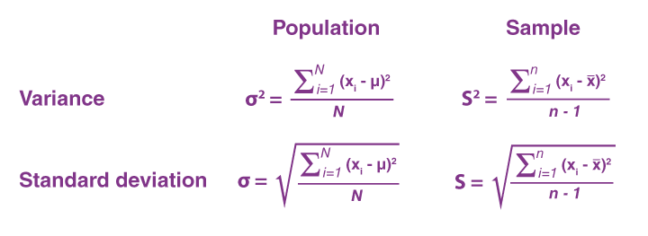
Variance and standard Deviation Formulas

Slide 14
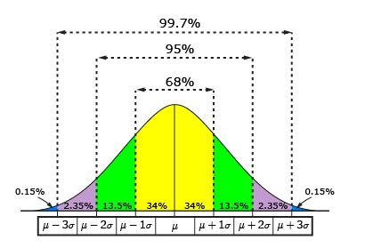
The normal curve
Also called the bell curve or Gaussian distribution,
Is a histogram of probability distribution for a continuous random variable
Calculated by probability density function.
Symmetry: Perfectly symmetrical, with mean, median, and mode at the center.
Bell-shaped: Forms a distinctive bell shape with a single peak.
3 Sigma Rule: 68% 1SD , 95% 2SD and 99.7% 3SD
Tails: are thin and extend infinitely, with the probability of extreme values gradually decreasing as you move away from the mean.
Mean and Standard Deviation: Mean and standard deviation define the curve's shape. Different means and standard deviations result in different normal distributions.

Slide 15
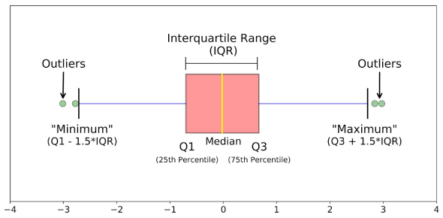
The Box Plot or 5 Number Summary
A box and whisker plot—also called a box plot—displays the five-number summary of a set of data.
Min = Minimum
Q1 = First Quartile
Median
Q3 = Third Quartile
Max = Maximum

Slide 16
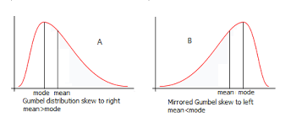
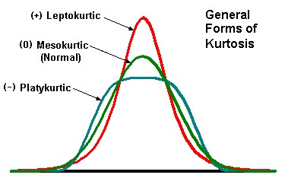
Measures of Shape
Skewness: Indicates the asymmetry in the data distribution.
Kurtosis: Describes the shape of the data's distribution,
specifically its tails and peak.

Slide 17
Measures of Position
Percentiles: Values that divide a dataset into hundredths (e.g., 25th percentile, 75th percentile).
Quartiles: Values that divide a dataset into four equal parts (Q1, Q2, Q3).

Slide 18
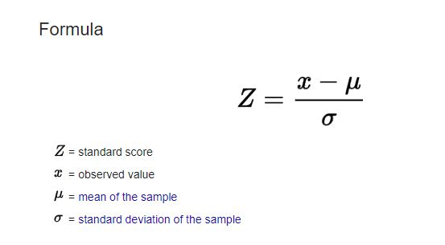
Standard Scores
Z-Score:
A measure of how many standard deviations a data point is from the mean. It standardizes data for comparison.

Slide 19
Outliers
Uni-variate outliers using
Box plot
Z-scores
Interquartile Range (IQR)
Calculate IQR
Calculate lower and upper bounds
Lower Bound = Q1 - 1.5 * IQR
Upper Bound = Q3 + 1.5 * IQR
All points outside bounds are outliers!

Slide 20
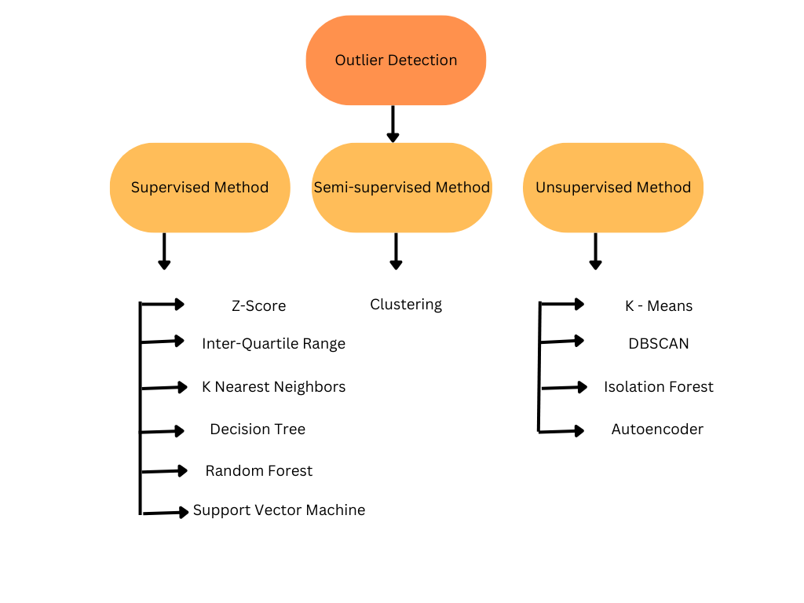
Outliers detection in ML

Slide 21
Correlation Vs Covariance
Provide insights into the relationship between two variables
Correlation
Covariance
The degree to which two variables change together, tells direction but not strength of relationship
+ Covariance: Variables move together.
-Covariance: Variables move in opposite directions.
Zero Covariance: Weak linear relationship; could be other relationships.
Comparing Covar:
Bigger values = stronger link
Score has Dimension
Indicates the direction of the linear relationship
Score is not standard
The magnitude of covariance is not standardized, so it can be challenging to interpret the strength of the relationship.
A "relationship score" for two Variables
Lies between -1 and +1
+1 means they're best friends
-1 means they're total enemies
0 means they don't care about each other
Score has no Dimension
Score is standard (means it doesn’t have any special unit), This quality makes it very easier to compare between two variables regardless of their respective Units or scales etc.

Slide 22
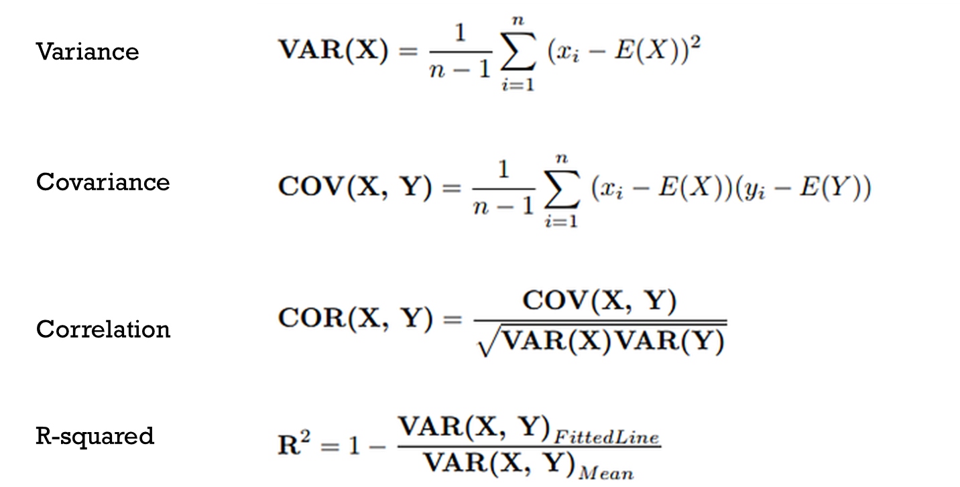
Correlation Vs Covariance
Formulas

Slide 23
Correlation is not Causation
Smoking and Lung Cancer: Correlation vs. Causation
Correlation:
Classic example of a correlation: Smoking and lung cancer.
Multiple studies consistently show that smokers are more likely to develop lung cancer.
Strong correlation supported by extensive evidence, including epidemiological studies.
Causation:
Correlation is not the same as causation.
Causation implies one variable directly causing changes in another.
In smoking and lung cancer, a strong correlation doesn't imply direct causation.
Complex relationship: Smoking contributes but isn't the sole cause.
Genetics, environmental pollutants, and occupational hazards are additional factors.
Causality Implies Association:
Causality suggests direct contribution of one variable to another.
In smoking and lung cancer, smoking directly increases lung cancer risk.
Supported by biological mechanisms and a clear dose-response relationship.
More smoking leads to a higher risk of lung cancer.

Slide 24
Confounding Variable
The third wheeler in relationship of two
Sometimes, there is a third variable that is not accounted for, which can affect the relationship between the two variables under study.
Example - Ice-Cream Sales and Shark Attacks:
A researcher collects data on ice-cream sales and shark attacks and finds a high correlation, which is unlikely on its own.
More likely cause is the confounding variable: temperature.
Requirements for a Confounding Variable:
1. Correlation with the Independent Variable:
It must be correlated with the independent variable.
In the example, temperature is correlated with ice-cream sales, as warmer weather leads to increased ice-cream sales.
2. Causal Relationship with the Dependent Variable:
It must have a causal relationship with the dependent variable.
In the example, temperature also affects the likelihood of people going into the ocean (warmer weather leads to more ocean activity), which, in turn, affects the likelihood of shark attacks.

Slide 25
Challenges of Confounding Variables in Machine Learning:
Bias in Predictive Models: Unaddressed confounding variables can introduce bias, leading to inaccurate predictions.
Over fitting: Over fit models may capture spurious relationships between confounding variables and outcomes, reducing generalizability.
Feature Importance and Selection: Confounders may be incorrectly identified as important features, leading to misleading feature selection.
Causal Inference: Essential for understanding causal relationships; failure to control for confounding can result in incorrect conclusions.
Fairness and Bias Issues: Models may perpetuate biases when confounding variables like gender are unaccounted for, leading to discrimination in predictions.
Data Preprocessing and Cleaning: Confounding variables can complicate data preprocessing, affecting techniques like normalization and cleaning.
Generalization Issues: Models reliant on specific confounding variables from training data may not generalize well to new, unseen data.
In ML we use techniques such as feature engineering, stratified sampling, propensity score matching, and causal inference methods like instrumental variables to address challenges of confounding variables.

Slide 26
Uni-Variate Analysis
focuses on examining a single variable,
Non-Graphical
Analysis through
Graphical
Analysis through Graphs
Summary Statistics
Z-scores
Histograms
Box plots
Stem-and-leaf plots
Line plots

Slide 27
Bi-Variate Analysis
Examination of two variables to understand their relationship,
Non-Graphical
Graphical
Correlation
Covariance
Cross Tabulation/contingency
T test
Chi-Squared test
ANOVA
Bivariate regression, or simple linear regression
Scatter plots
Bubble Charts
Heat maps
Line plots
Violin plots

Slide 28
Multi-Variate Analysis
Explores relationships between three or more variables
Especially to understand the relationships and dependencies between multiple variables simultaneously
Non-Graphical
Graphical
Cross tabulation
Correlation
Covariance
MANOVA
Principal Component Analysis (PCA)
Factor Analysis
Cluster Analysis
Discriminant Analysis
Multi dimensional scaling
Multivariate Regression
Correlation Scatterplots
Pair plots
Correlation Heat maps
3D scatter plot

Slide 29
INFERENTIAL STATISTICS

Slide 30
INFERENTIAL STATISTICS
Helps us in making Inferences or prediction about a Population based on a Sample
Probability
Hypothesis testing
ANOVA
Regression

Slide 31
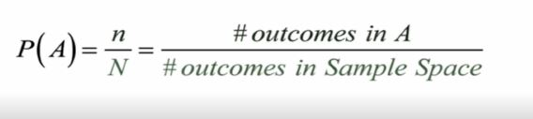
Probability
Probability is a concept where we try to quantify how likely it is for an event to occur!
Or what is the chance of an occurrence of an event?
Event: A specific outcome or a set of outcomes we are interested in
The Probability of an Event A : The probability of an event E, denoted as P(A), is a value between 0 and 1, where 0 means the event is impossible, and 1 means the event is certain to occur.
Complimentary event: Two events where one will occur another will occur as well
Mutually Exclusive event: Cannot occur at same time
Outcomes: The individual results of the experiment
Sample spaces: The set of all possible outcomes

Slide 32
Where is probability used in ML
Probability distribution (Normal, Poisson, Bernoulli, Binomial and exponential etc.)
Confidence interval
Bayes Theorem
Conditional Probability
Central Limit theorem
Marcovs chains , hidden Markovs chains method

Slide 33


Sample Space of a Random Experiment (Rolling 2 dice)
 | 1 | 2 | 3 | 4 | 5 | 6
1 | 1,1 | 1,2 | 1,3 | 1,4 | 1,5 | 1,6
2 | 2,1 | 2,2 | 2,3 | 2,4 | 2,5 | 2,6
3 | 3,1 | 3,2 | 3,3 | 3,4 | 3,5 | 3,6
4 | 4,1 | 4,2 | 4,3 | 4,4 | 4,5 | 4,6
5 | 5,1 | 5,2 | 5,3 | 5,4 | 5,5 | 6,6
6 | 6,1 | 6,2 | 6,3 | 6,4 | 6,5 | 6,6

Slide 34
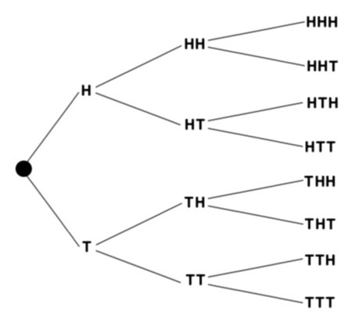
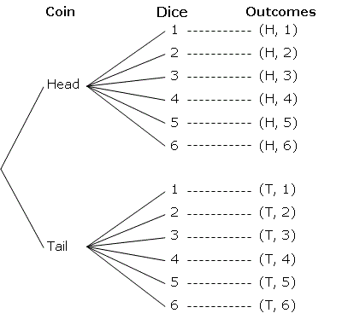
Random Experiment Example:
1st Sample space of flipping a coin three times
2nd Sample space of flipping a coin and Rolling a Dice

Slide 35
Random Variable
A variable that can take on different values as outcomes of a random process or experiment. These values are associated with probabilities.
Discrete Random Variable
countable number of distinct values typically separated by gaps, and there are no values between them.
events having a distinct count number
The number of heads obtained when flipping a coin multiple times.
The number of people in a household.
The number of cars passing through a toll booth in an hour.
The count of emails received in a day.
Probability Mass Function (PMF) is used for assigning probabilities to each possible values to a discrete random variable
Continuous Random Variable
can take on an uncountable infinite number of values within a certain range.
typically measured and can take any real number within a given interval.
Like measurements and quantities that can take on a wide range of values.
The height of individuals in a population.
The time it takes for a computer program to execute.
The temperature in a given location.
The weight of a product coming off a manufacturing line
Probability Density Function (PDF) is used for probability associated with these values distributed over a range to a continuous random variable

Slide 36
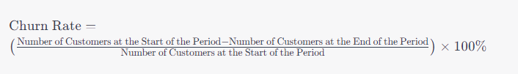
Examples of Discrete Random Variable
NO OF CUSTOMERS ARRIVAL IN A STORE PER DAY
Number of orders received in ecommerce webpage
Customer churn (or customers leaving shopping with this firm)

Slide 37
Examples of Continuous Random Variable
Market share of company(0 to 100 percent)
Weight of individuals
Time taken to complete order placed on ecommerce webpage
Height of individuals

Slide 38
Probability rules:
RULE
Probability of an impossible event is zero
Probability of a certain event is 1
Probability lies between 0 and 1space
Therefore for an even A the probability ;
P(0≤A≤1)
RULE
For sample space S the probability of an event is event probability divided by sum of all probabilities in sample

Slide 39
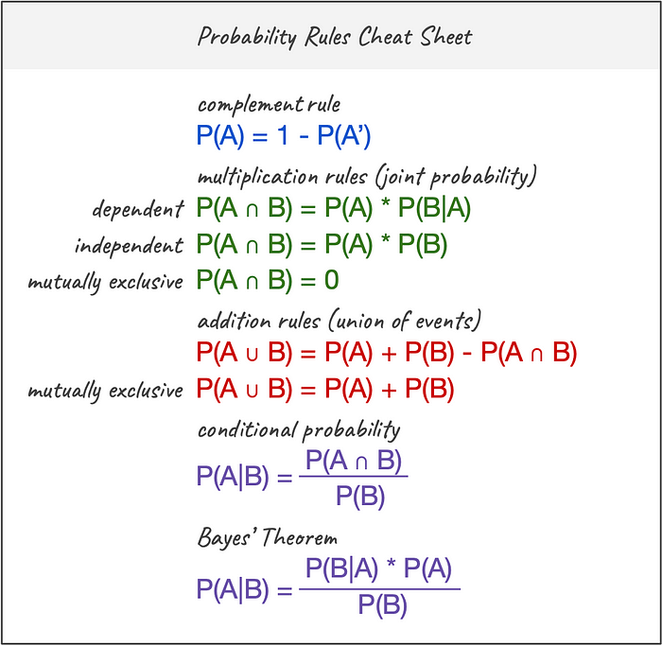
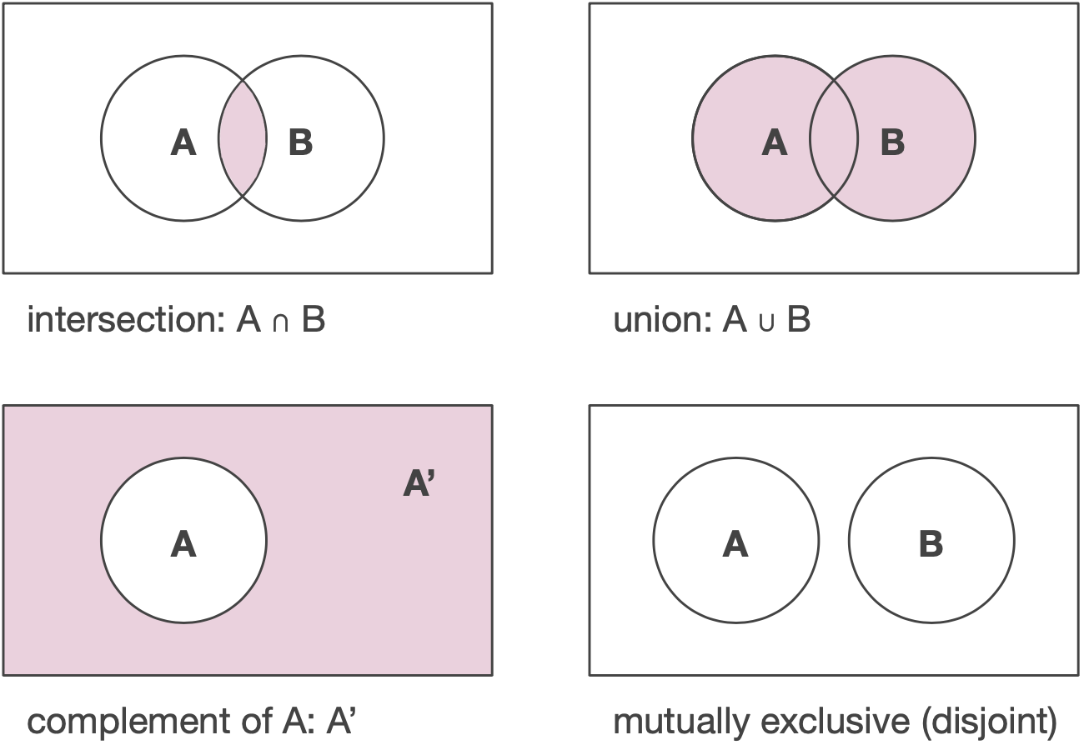
Probability rules
Addition Rules
P(A or B)=P(A)+P(B)
Multiplication Rules P(A and B)=P(A)⋅P(B)
Complement Rule
P(not A)=1−P(A)

Slide 40
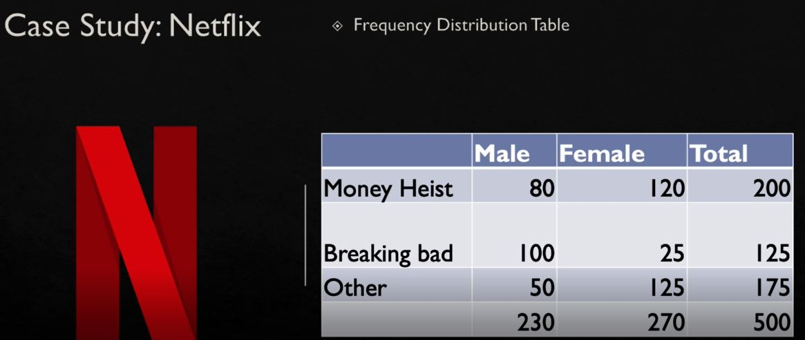
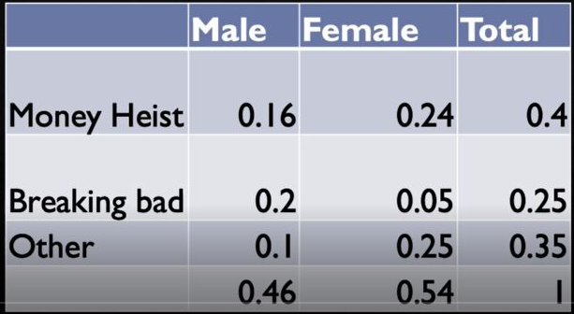
Marginal and joint probability
Case study:
Netflix shows
Frequency distribution Table
Probability distribution Table

Slide 41
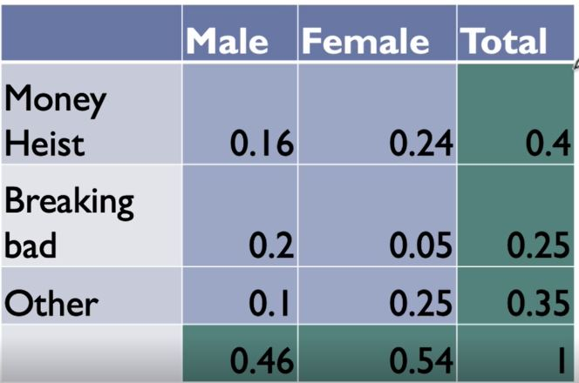
Marginal probability on the margins
Joint probability of two occurrences simultaneously

Slide 42
Conditional Probability and Bayes' theorem.
Conditional probability is a likelihood of an event occurring based on previous probability which are known in advance.
Probability of an Event A given B has occurred
Multiplication rule for conditional Probability
Specific rule:
P(A n B)=P(A)⋅P(B∣A)
General Rule:
P(A n B n C)=P(A)⋅P(B∣A)⋅P(C∣A n B)

Slide 43

Bayes' Theorem
Bayes' Theorem is simply a formula for finding conditional probability based on prior information, its finding new information based on prior evidence
Where:
P(A∣B) is the posterior probability of event A occurring given that event B has occurred. This is the probability we want to calculate.
P(B∣A) is the conditional probability of event B occurring given that event A has occurred. This represents our prior knowledge or belief about the probability of B given A.
P(A) is the prior probability of event A occurring, without considering the new evidence.
P(B) is the total probability of event B occurring, without considering the new evidence.

Slide 44
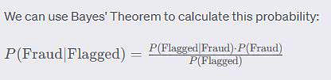
Credit Card Fraud Detection
Banks and credit card companies use sophisticated algorithms and models to detect and prevent credit card fraud. This is a critical application of conditional probability.
Scenario: Consider a bank's credit card fraud detection system. They want to determine the probability that a transaction is fraudulent,
Want to find: P(Fraud|Flagged)
Prior Information:
P(Fraud)=0.01 (Prior probability of a transaction being fraudulent).
P(Flagged∣Fraud)=0.98P(Flagged∣Fraud)=0.98 (True positive rate of the fraud detection system).
P(Flagged∣Not Fraud)=0.03P(Flagged∣Not Fraud)=0.03 (False positive rate of the fraud detection system).
We want to calculate P(Fraud∣Flagged)the probability that a transaction is fraudulent given that it was flagged by the system.

Slide 45
Hypothesis Testing
What is inferential statistics?
Concept of Population and sample
Difference between parameter and statistic
Hypothesis Testing
Regression Analysis

